Slide 1

Natural Language Processing
Research Method & Presentation Course
Reza Khan Mohammadi
1
Some slides borrowed from Diyi Yang at GaTech

Slide 2

Welcome!
I am Reza Khan Mohammadi…
NLP Researcher - Computer Engineering Student
It’s been almost 2 years since I entered AI.
My main focus of research is NLP.
By now, I have submitted two research papers, one in an international Journal and the other in an international Conference.
Currently working on 4 other papers.
2

Slide 3
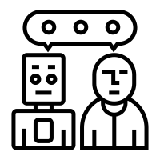
Today we will talk about Natural Language Processing (NLP)
3

Slide 4
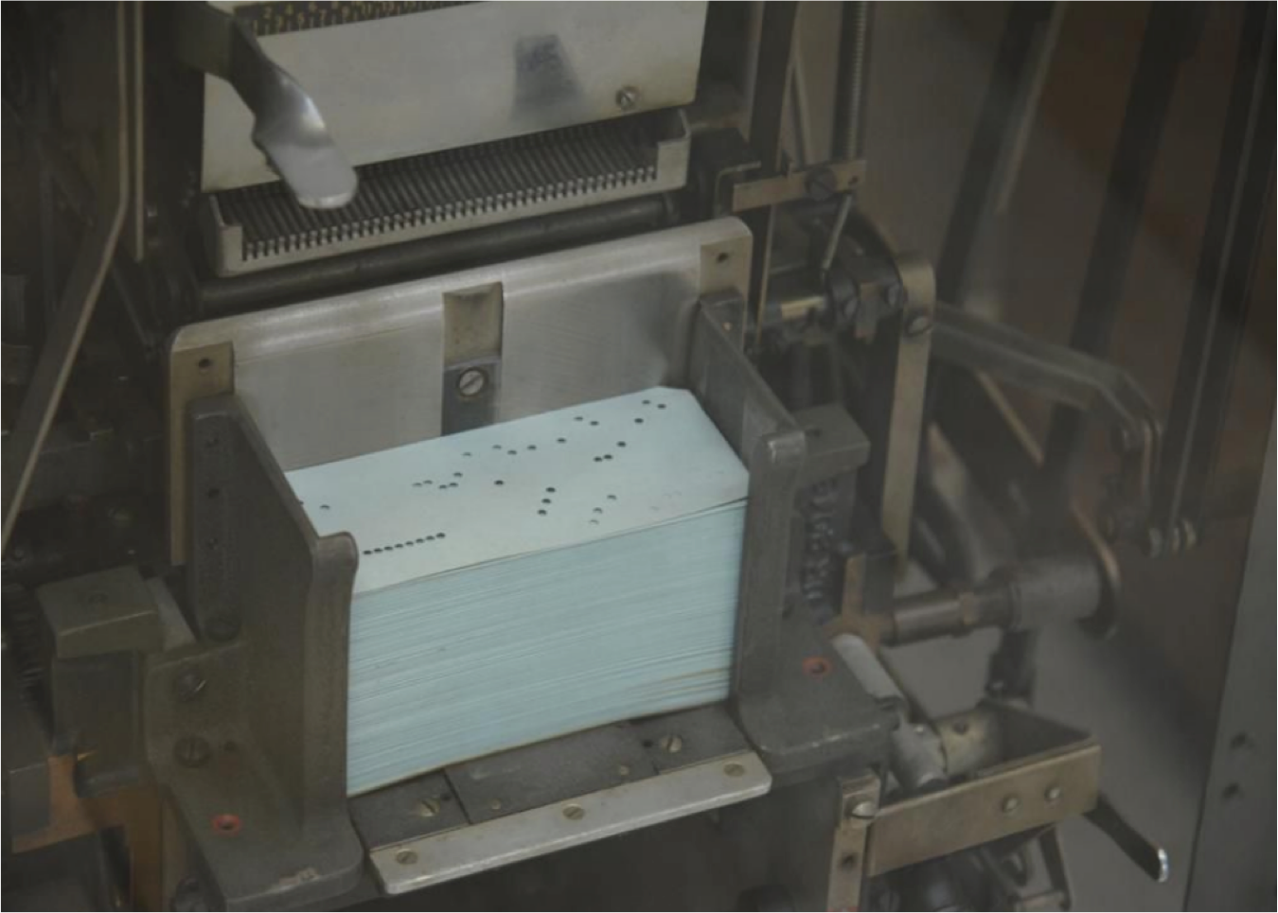
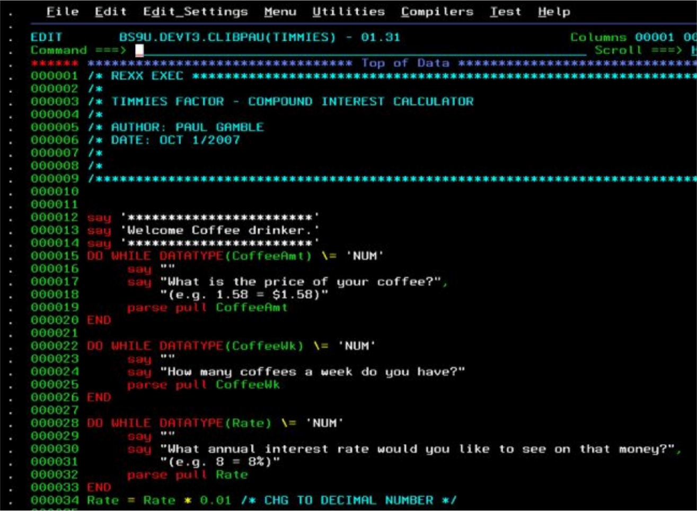
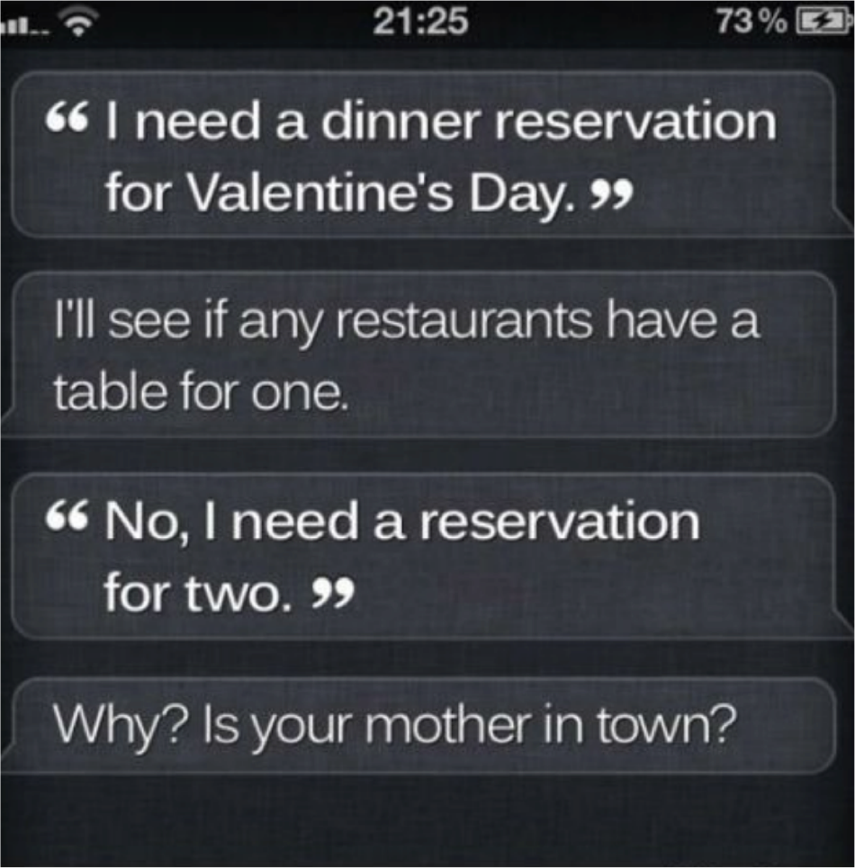
Communication With Machines
~50-70s
~80s
today
4

Slide 5

Different uses of Language
In our daily-life, we use language to...
write something.
Chat.
ask questions and answer.
Describe something.
…

Slide 6
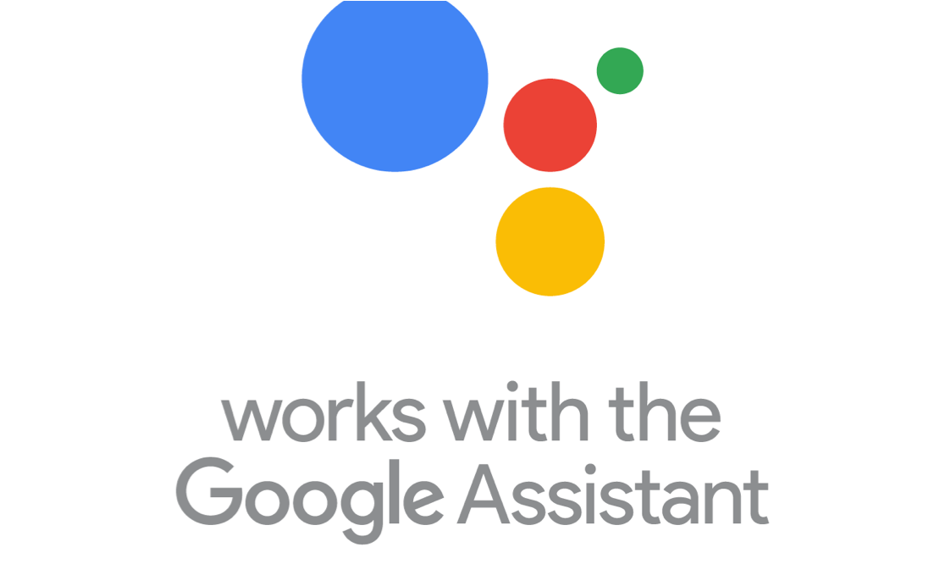

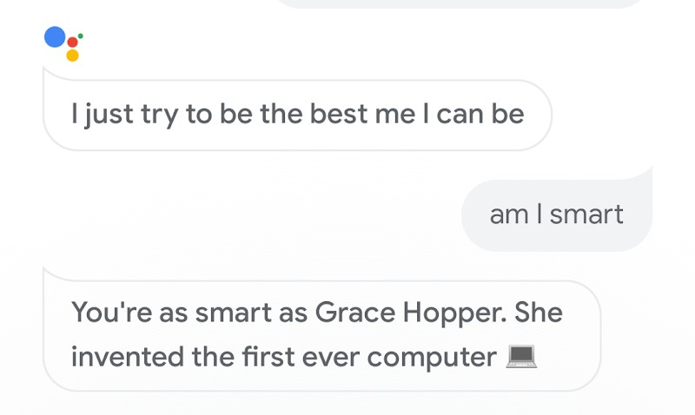
Conversational Agents
Conversational agents contain:
Speech recognition
Language analysis
Dialogue processing
Information retrieval
Text to speech
6

Slide 7
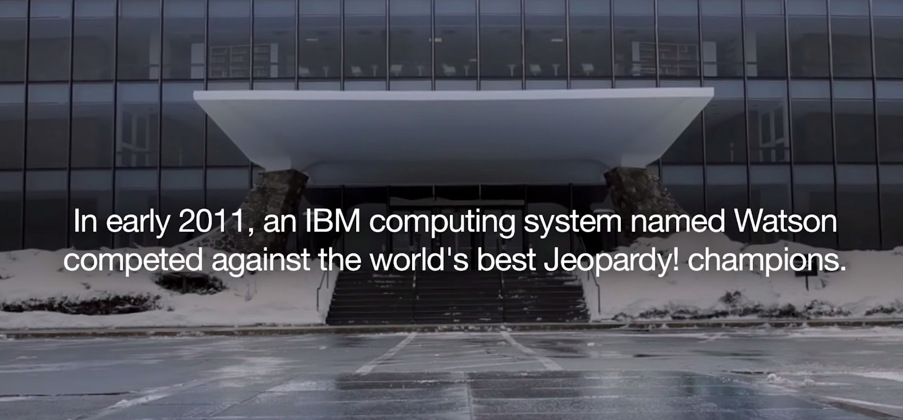
7

Slide 8
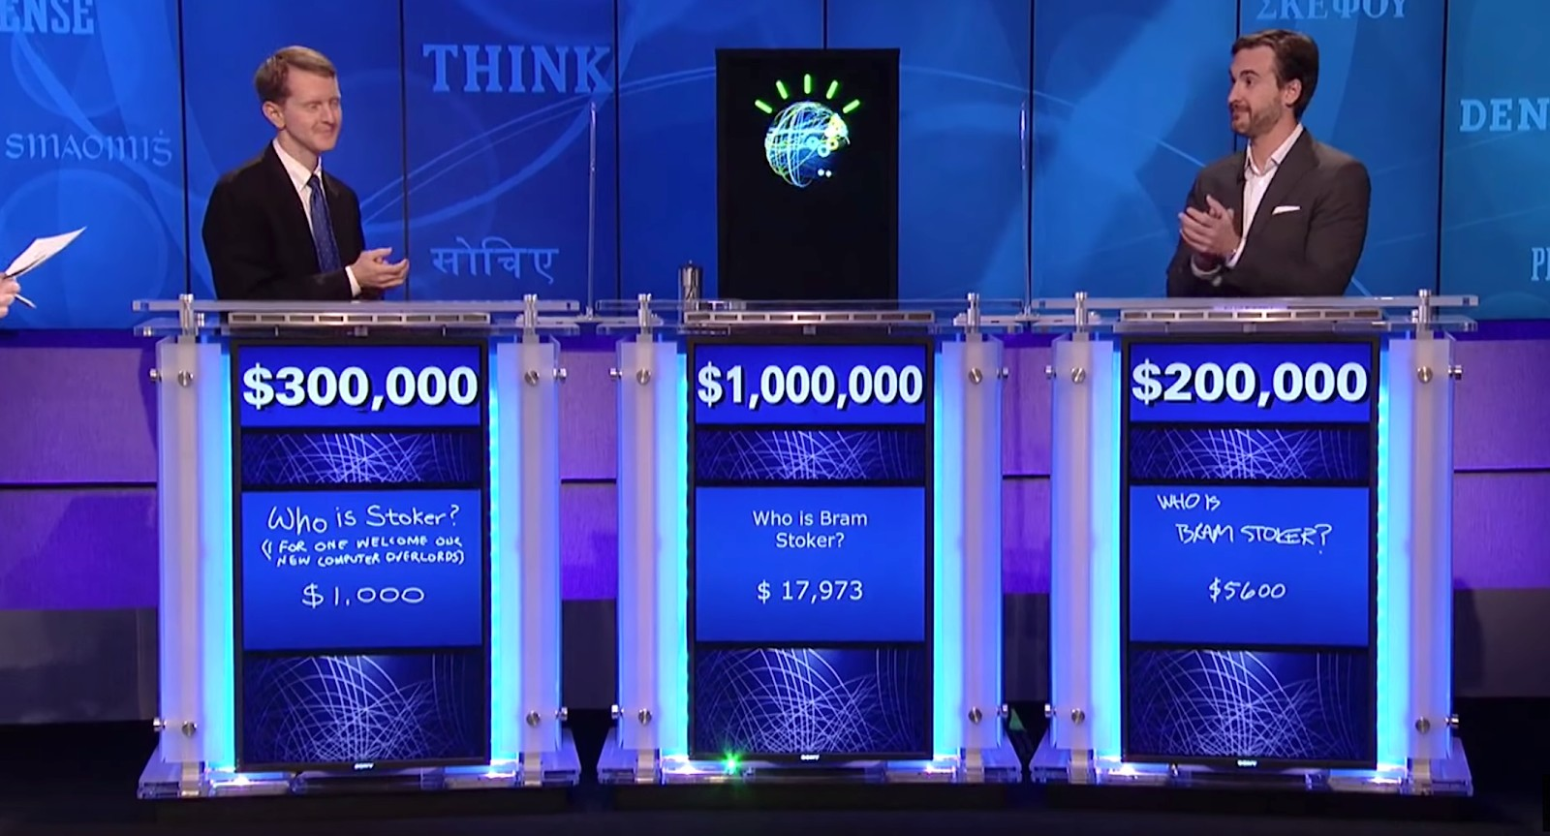
Question Answering
What does “divergent” mean?
What year was Abraham Lincoln born?
How many states were in the United States that year?
How much Chinese silk was exported to England in the end of the 18th century?
What do scientists think about the ethics of human cloning?
8

Slide 9
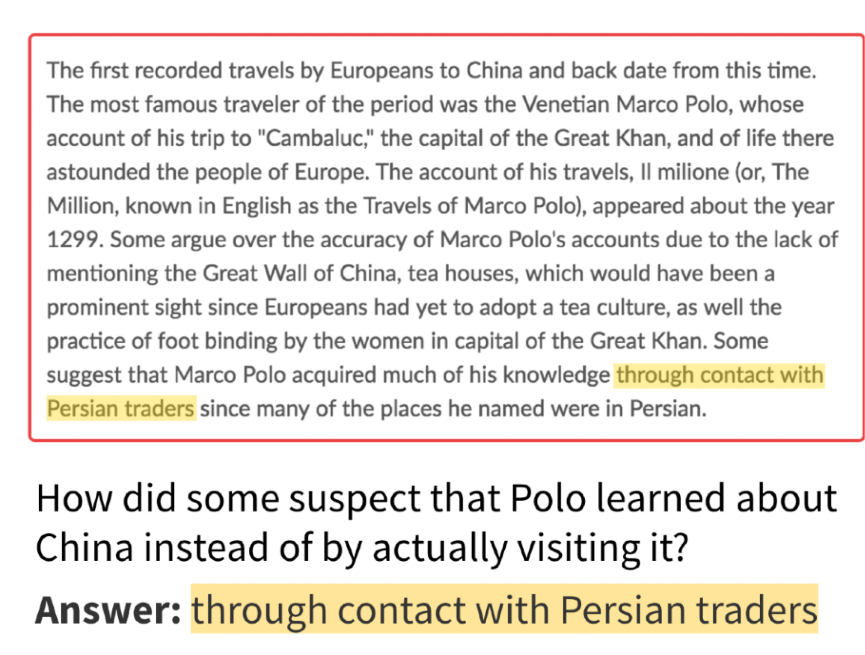
Textual Question Answering (Reading Comprehension)
(Rajpurkar et al, 2016): SQuAD: 100,000+ Questions for Machine Comprehension of Text
10

Slide 10
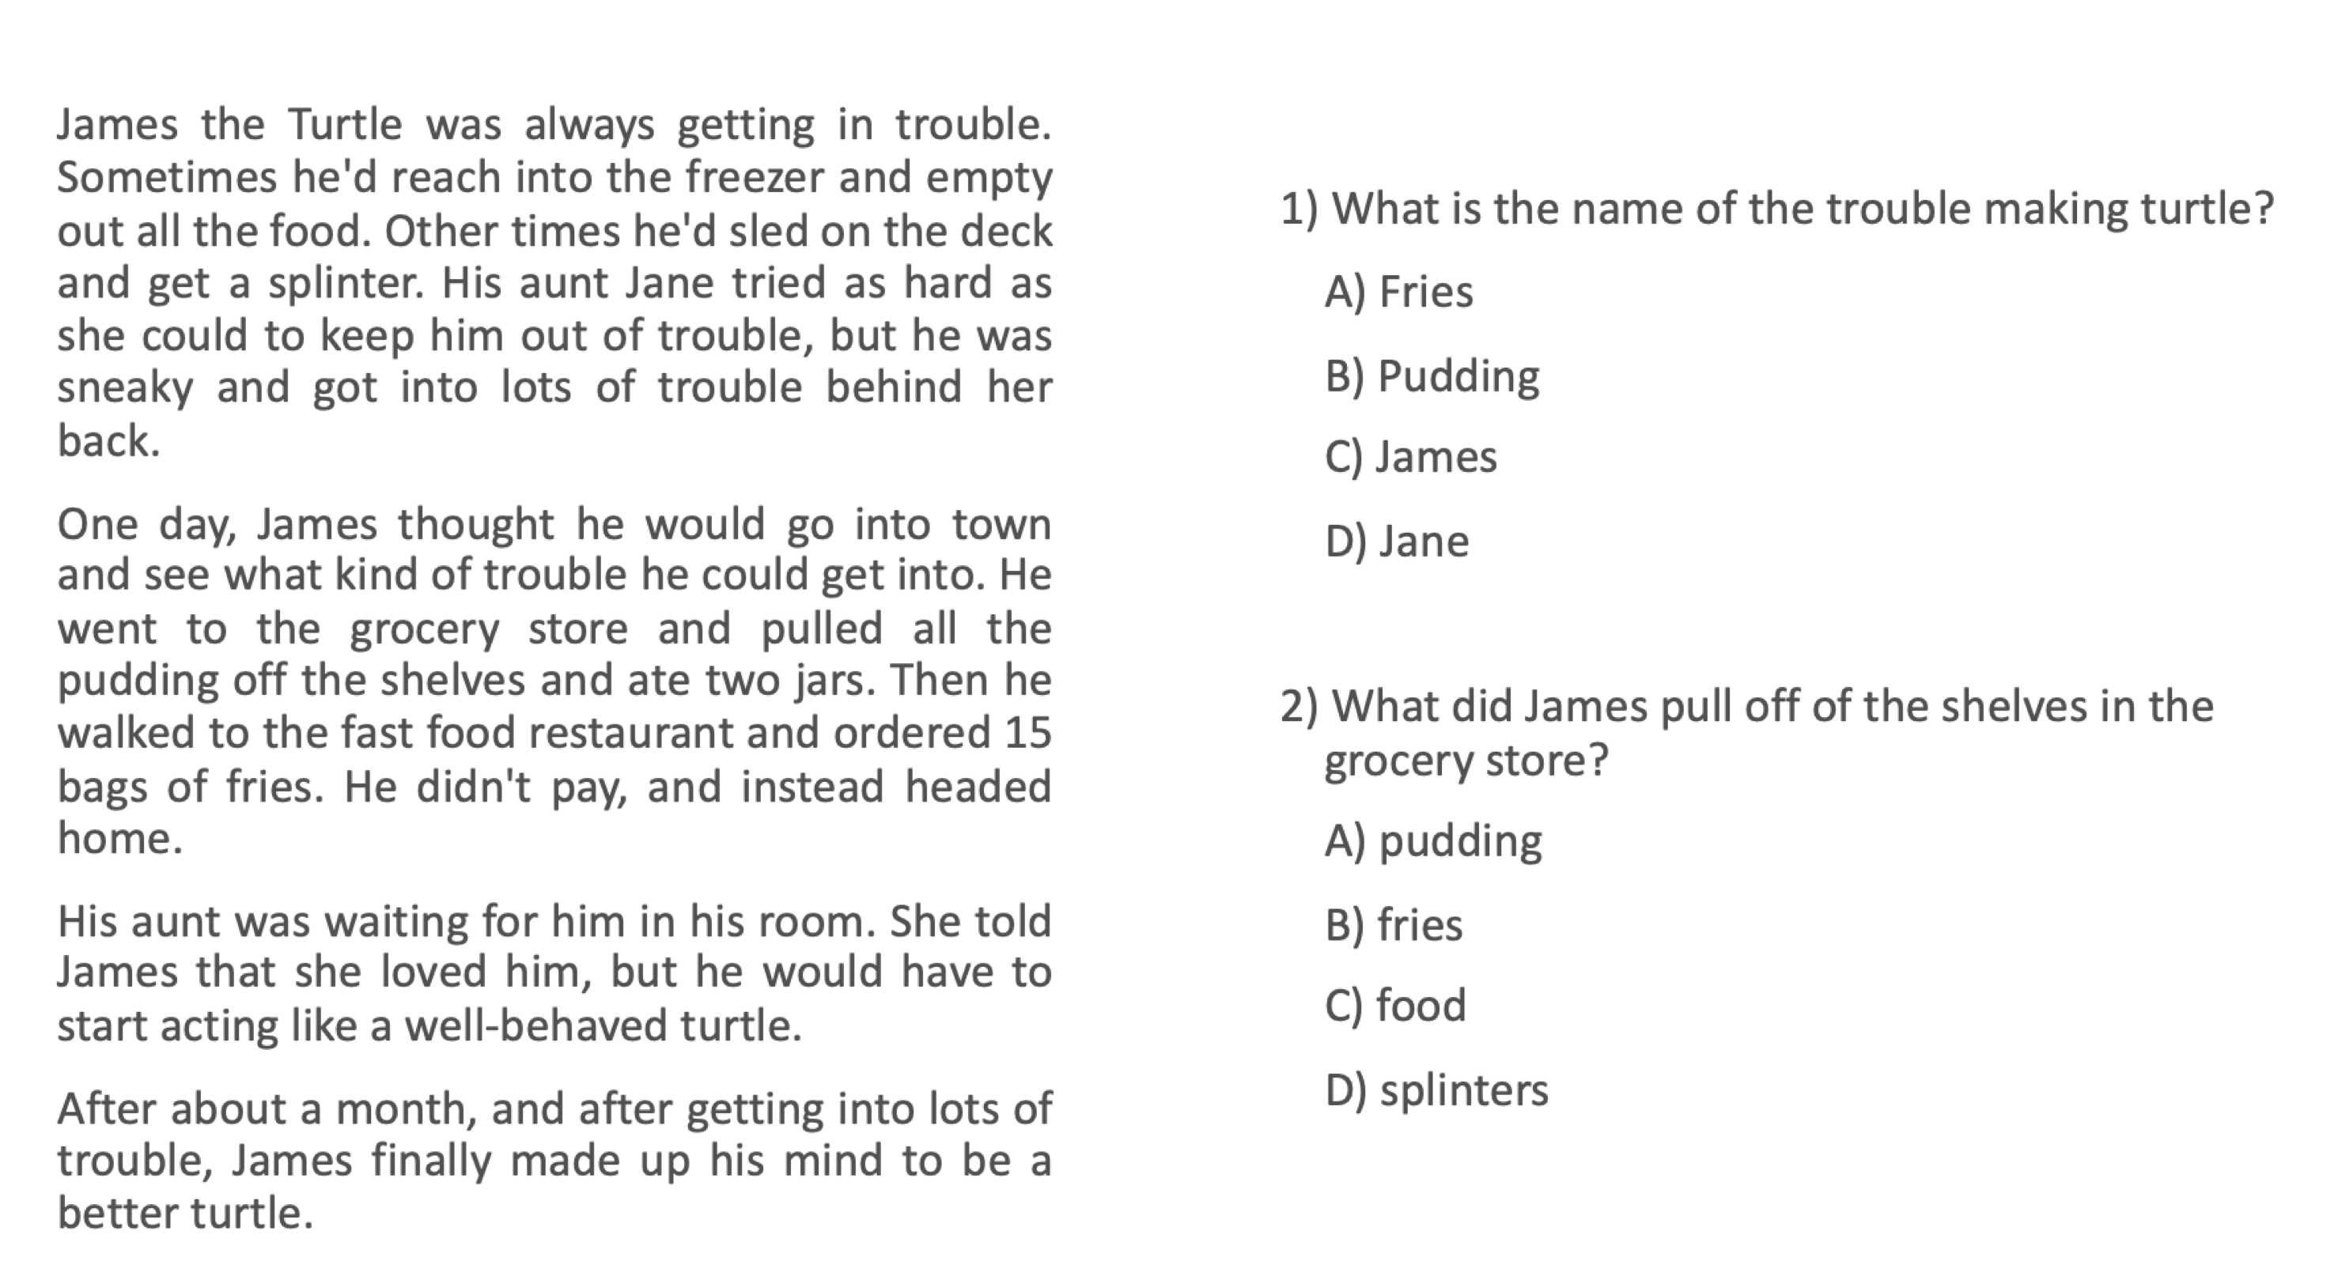
Textual Question Answering
(Richardson et al, 2013): MCTest: A Challenge Dataset for the Open-Domain Machine Comprehension of Text
11

Slide 11
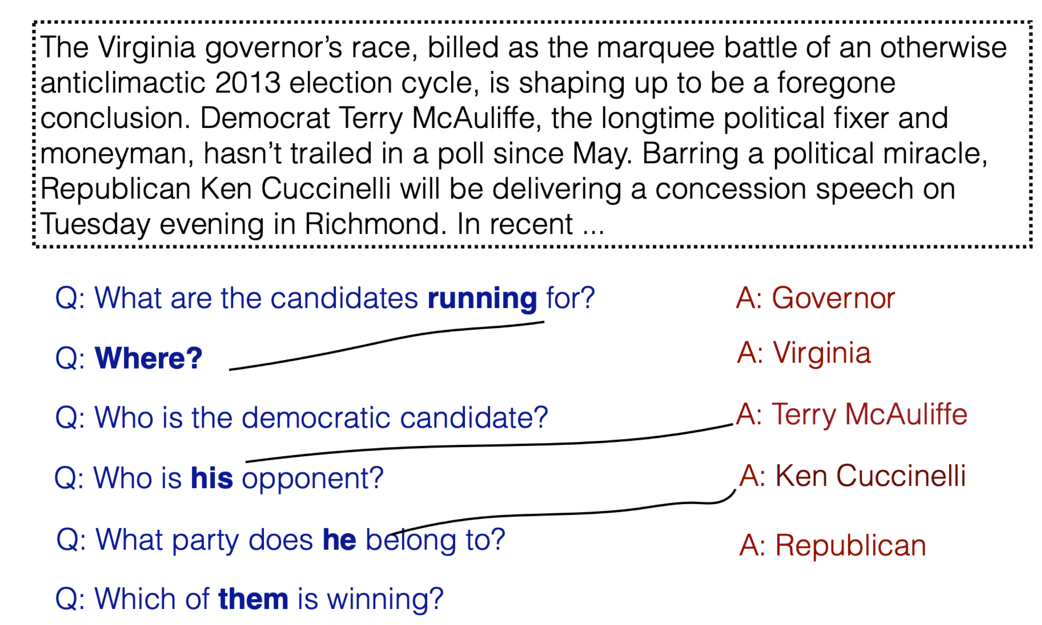
Conversational Question Answering
(Reddy et al, 2019): CoQA: A Conversational Question Answering Challenge
12

Slide 12
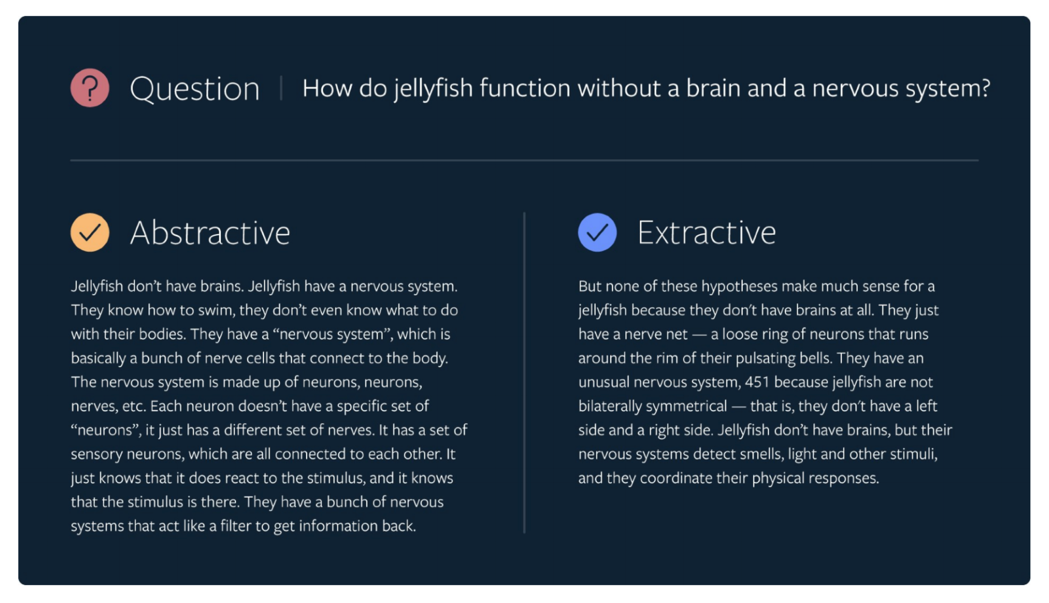
Long-form Question Answering
https://ai.facebook.com/blog/longform-qa/
(Fan et al, 2019): ELI5: Long Form Question Answering

Slide 13
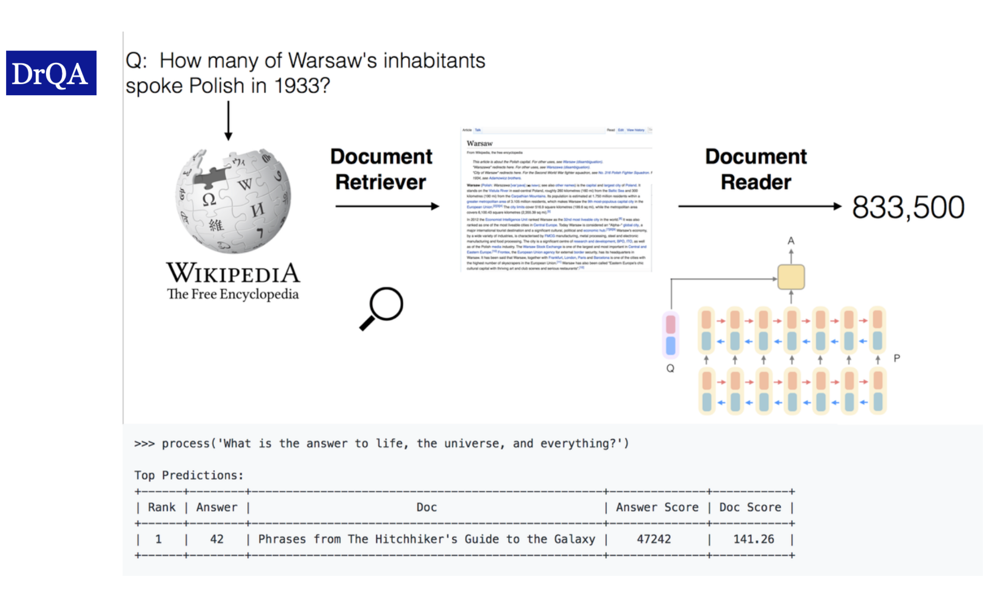
Open-domain Question Answering
(Chen et al, 2017): Reading Wikipedia to Answer Open-Domain Questions
15

Slide 14
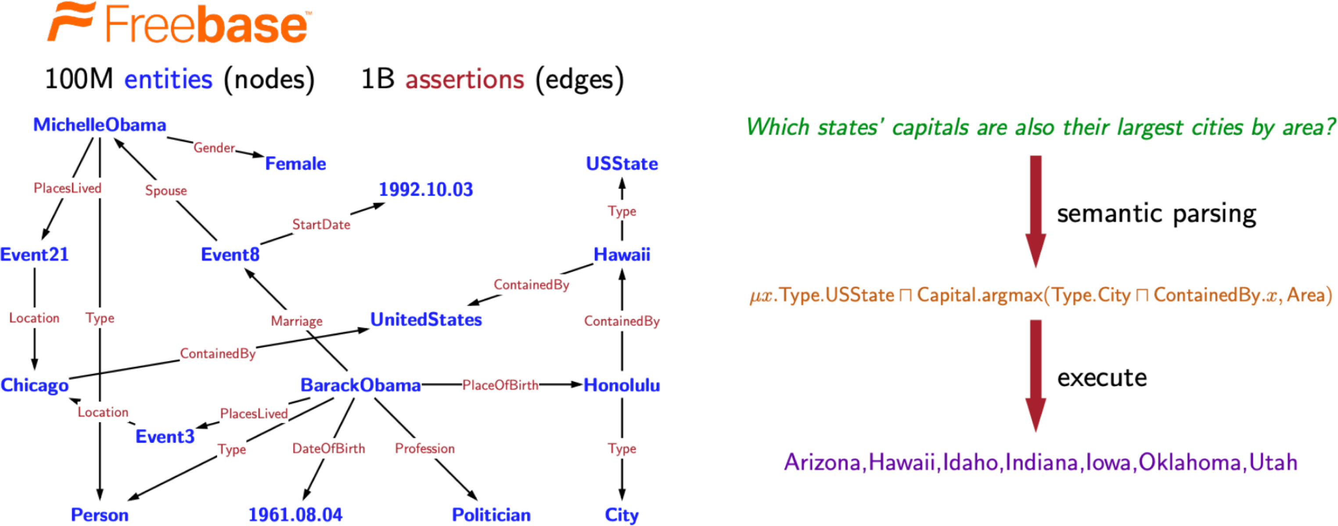
Knowledge Base Question Answering
(Berant et al, 2013): Semantic Parsing on Freebase from Question-Answer Pairs
16

Slide 15
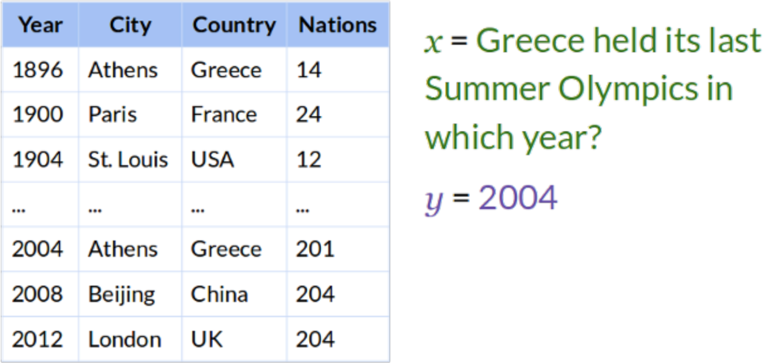
Table-based Question Answering
(Pasupat and Liang, 2015): Compositional Semantic Parsing on Semi-Structured Tables.
17

Slide 16
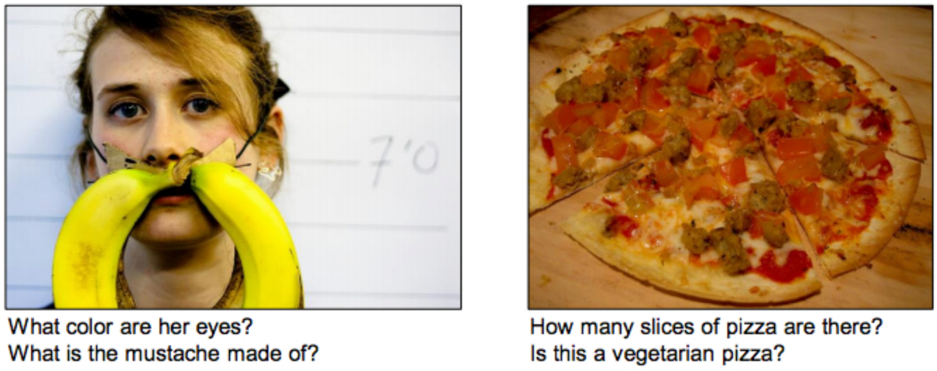
Visual Question Answering
(Antol et al, 2015): Visual Question Answering
18

Slide 17
Question Answering Datasets
Reading Comprehension
CNN/Daily Mail, CoQA, HotpotQA, QuAC, RACE, SQuAD, SWAG, Receipt QA, NarrativeQA, DROP, Story Cloze Test ……
Open-domain question answering
DuReader, Quasar, SearchQA, …
Knowledge base question answering
Check out more datasets: http://nlpprogress.com/english/question_answering.html
17

Slide 18
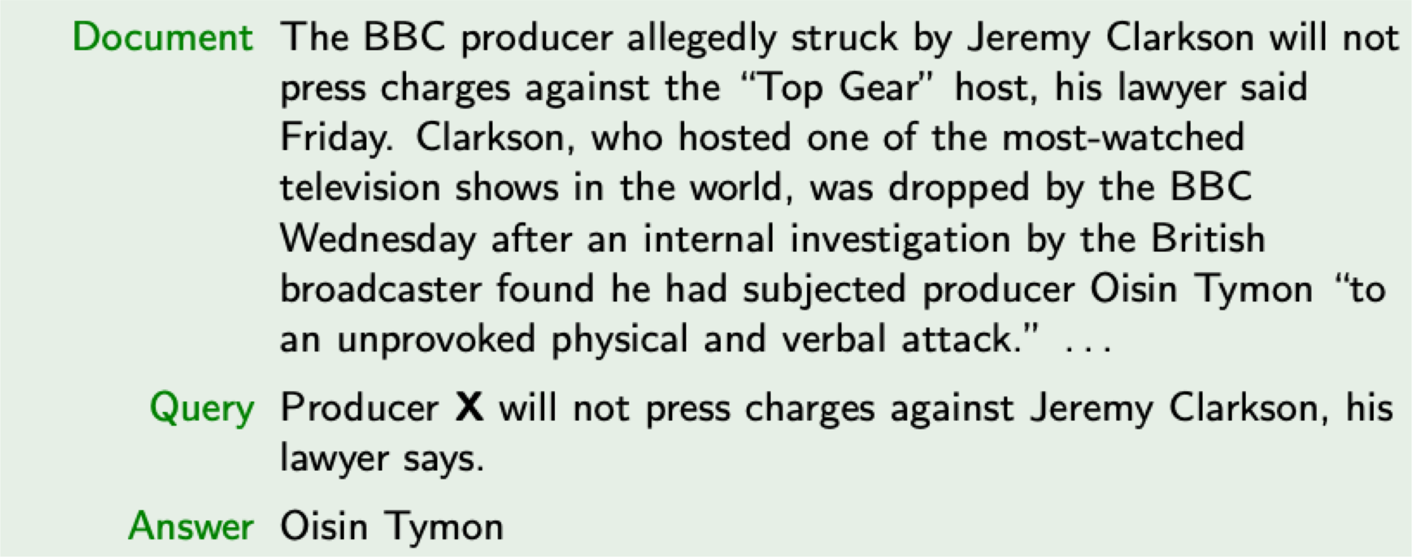
CNN Article

Slide 19
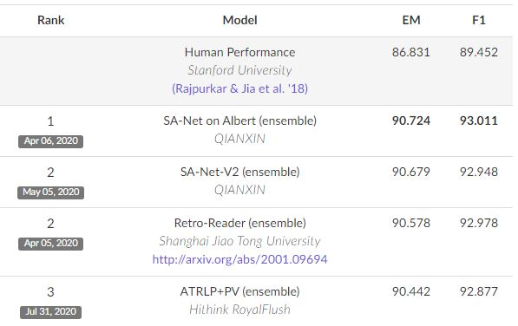
SQuAD Benchmark

Slide 20
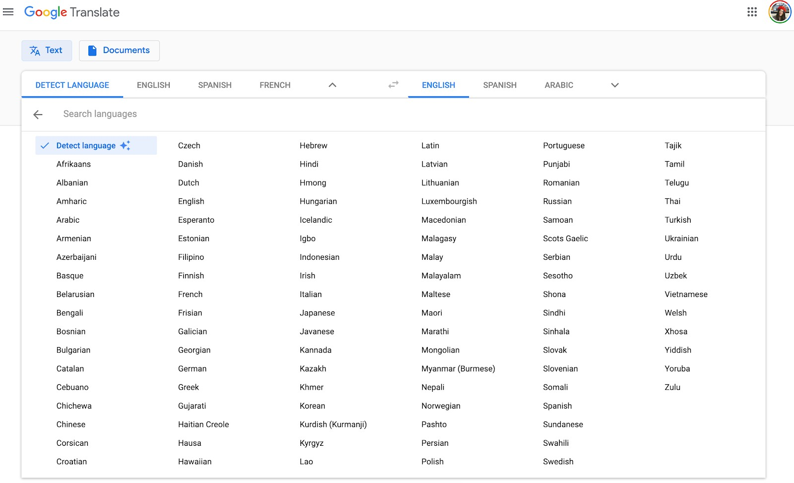
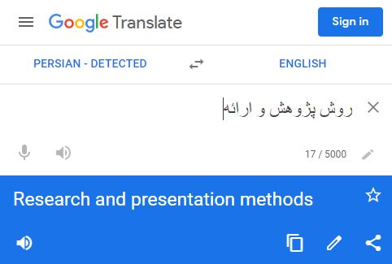
Machine Translation
20

Slide 21
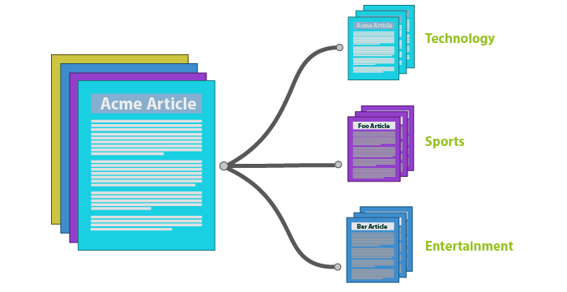
Classification
Text classification is the process of categorizing text into organized groups.

Slide 22
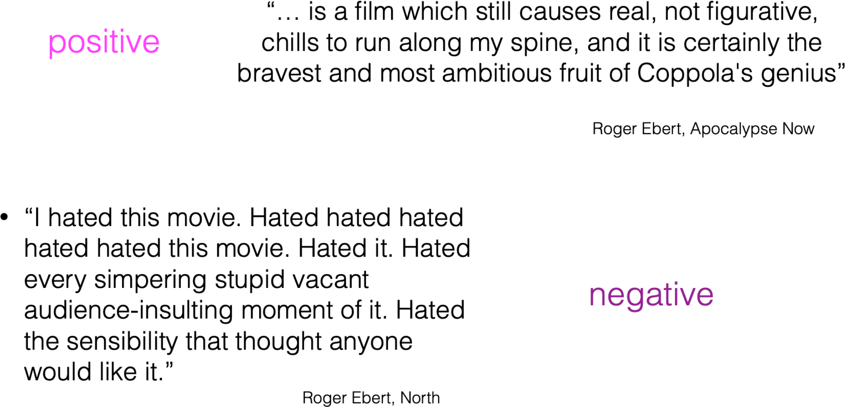
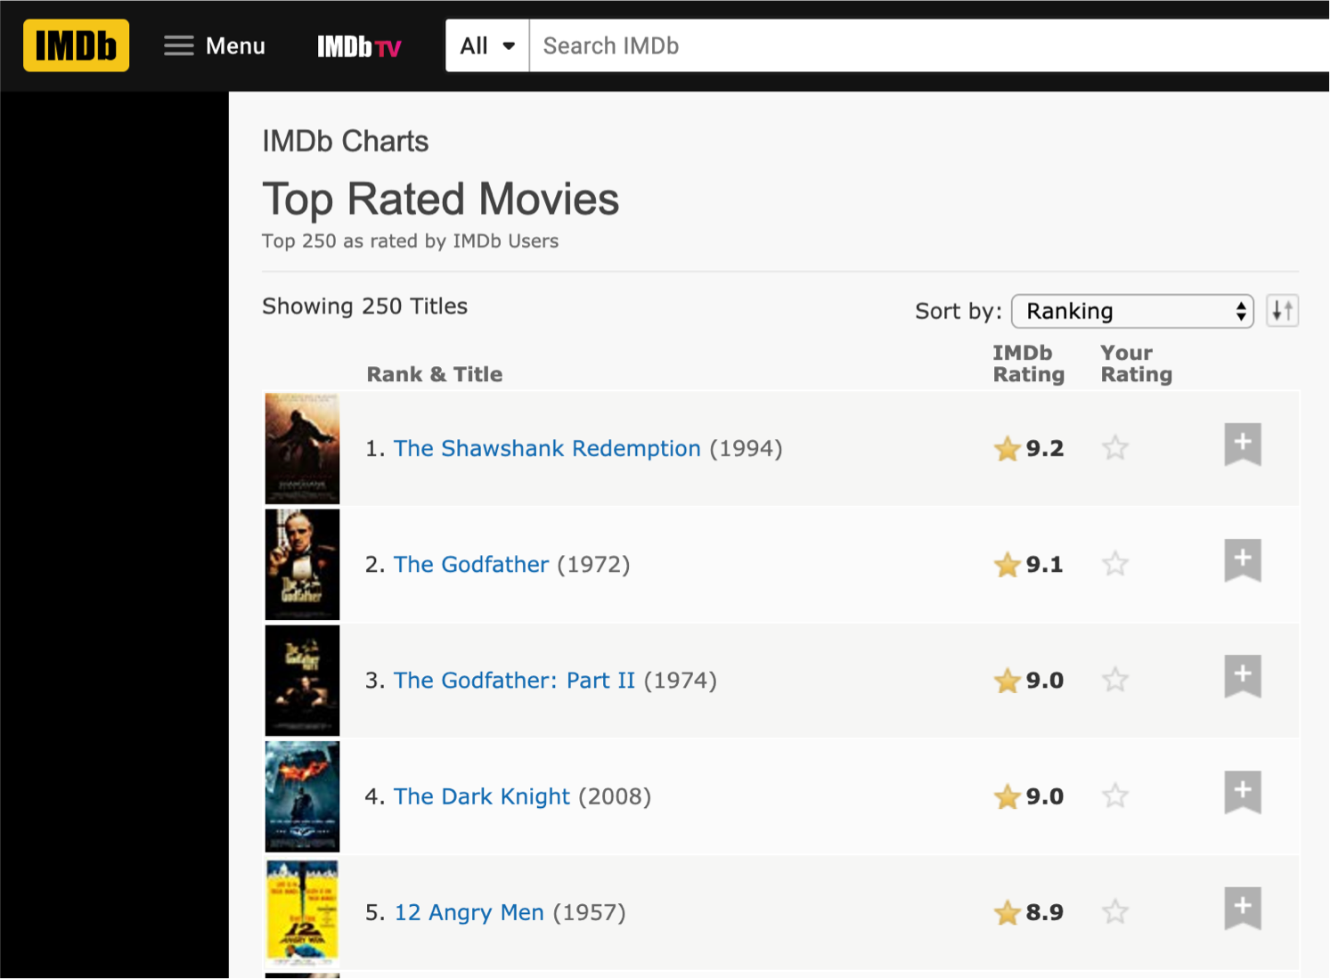
Movie Ratings

Slide 23
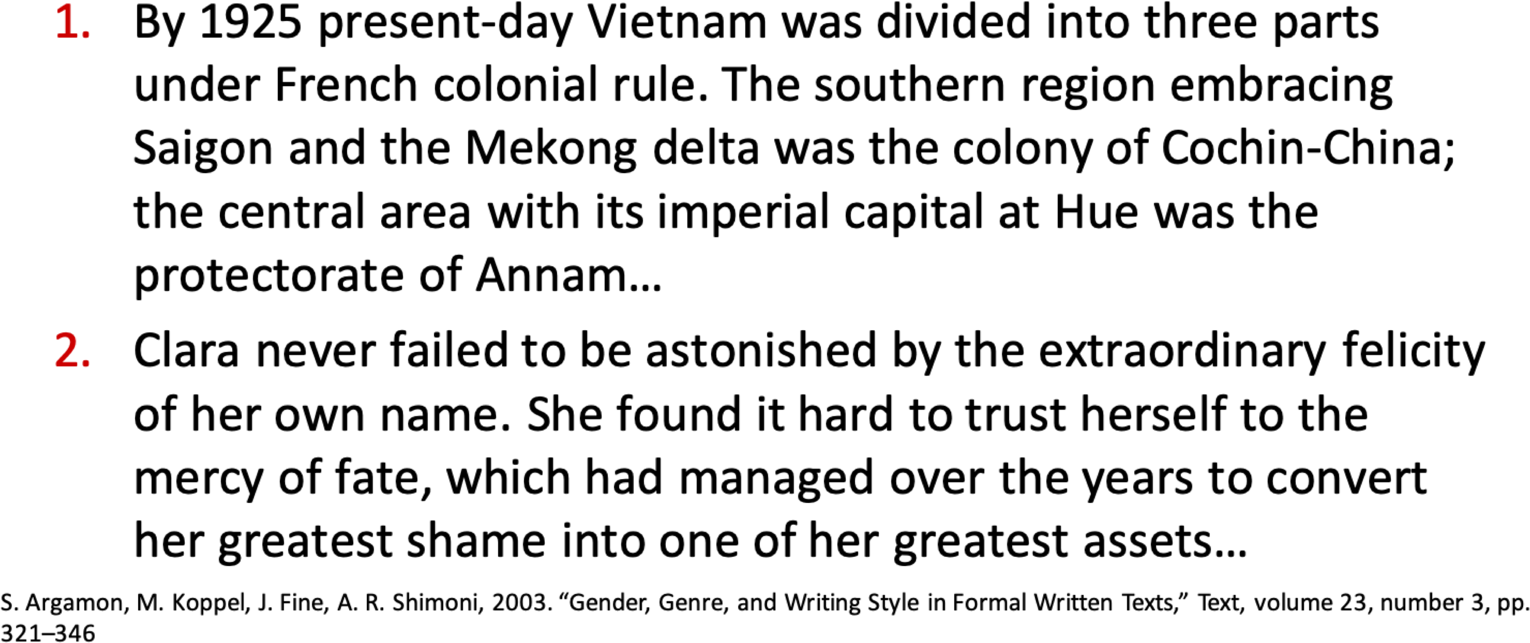
Female or Male Author?

Slide 24
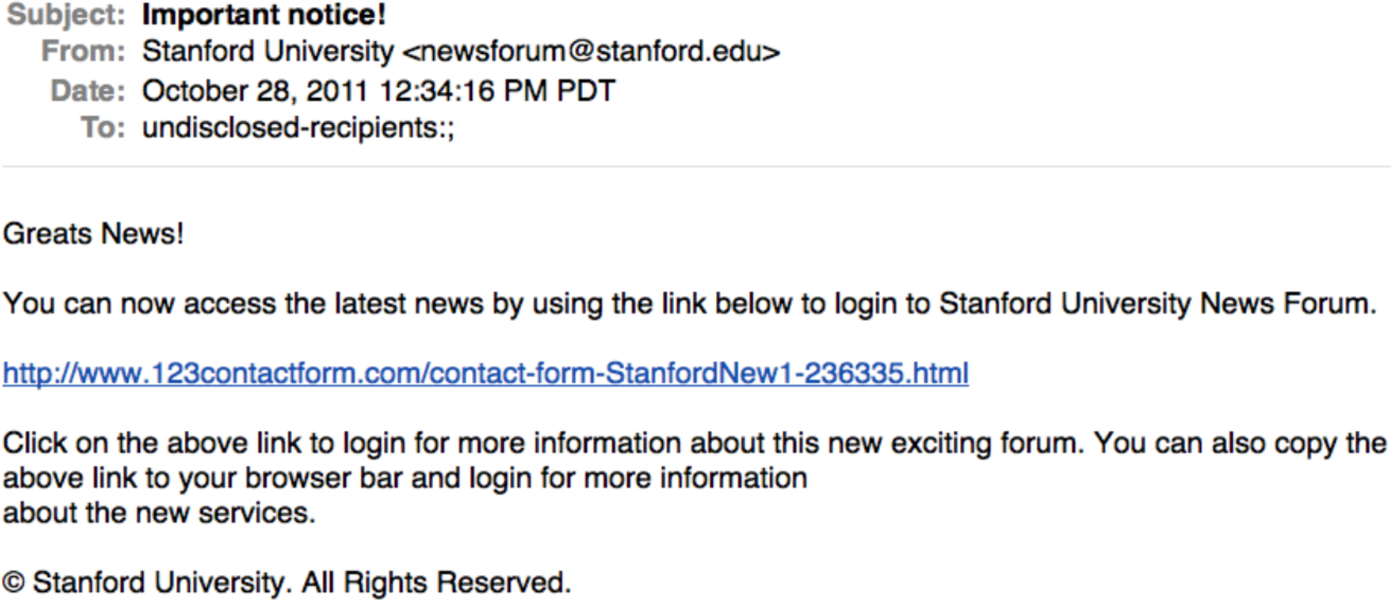
Is This Spam?

Slide 25
Natural Language Processing
Applications
Core Technologies
Machine Translation
Information Retrieval
Question Answering
Dialogue Systems
Information Extraction
Summarization
Sentiment Analysis
¡ ...
Language modeling
Part-of-speech tagging
Syntactic parsing
Named-entity recognition
Word sense disambiguation
Semantic role labeling
¡ ...
NLP lies at the intersection of Linguistics, Computer Science, and AI.
9

Slide 26


Ambiguity
Ambiguity at multiple levels
Word senses: bank (finance or river ?)
Part of speech: chair (noun or verb ?)
Syntactic structure: I can see a man with a telescope

Slide 27
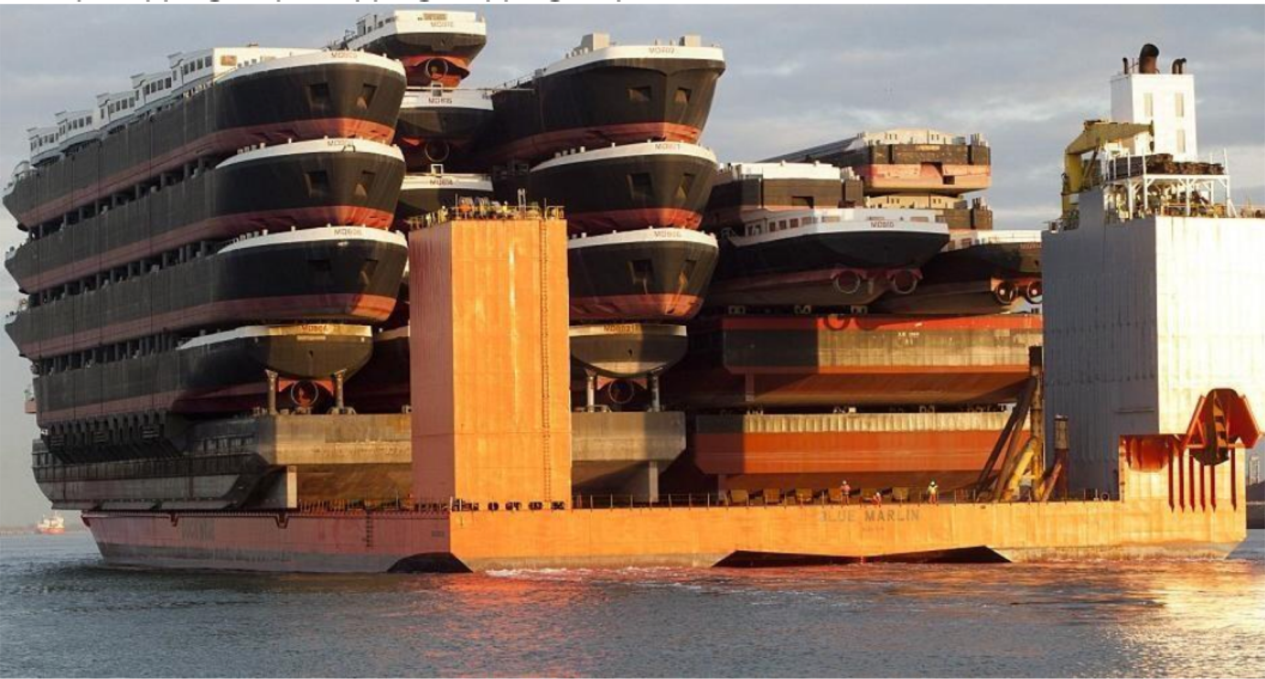
Ambiguity
A ship-shipping ship, shipping shipping-ships

Slide 28
Fields with Connections to NLP
Machine learning
Linguistics (including psycho-, socio-, descriptive, and theoretical)
Cognitive science
Information theory
Logic
Data science
Political science
Psychology
Economics
Education
28

Slide 29
Today’s Applications
Conversational agents
Information extraction and question answering
Machine translation
Opinion and sentiment analysis
Social media analysis
Visual understanding
Essay evaluation
Mining legal, medical, or scholarly literature
57

Slide 30
Factors Changing NLP Landscape
Increases in computing power
The rise of the web, then the social web
Advances in machine learning
Advances in understanding of language in social context
58

Slide 31
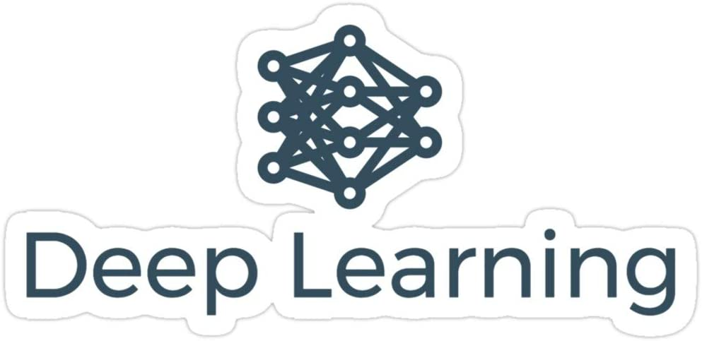
However, none of these were possible without…

Slide 32
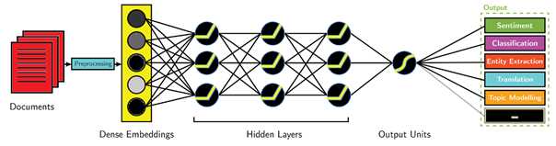
Deep Learning + NLP = Deep NLP

Slide 33
Personal Research Experience

Slide 34
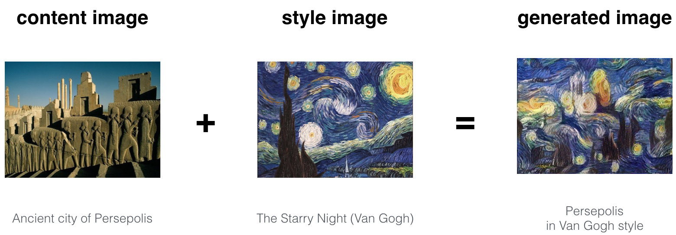
Neural Style Transfer

Slide 35
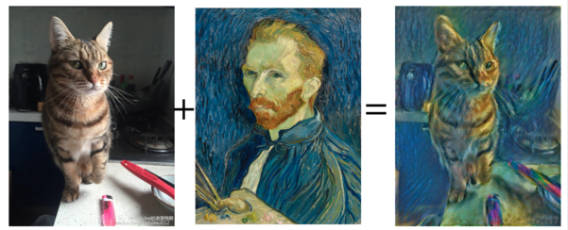
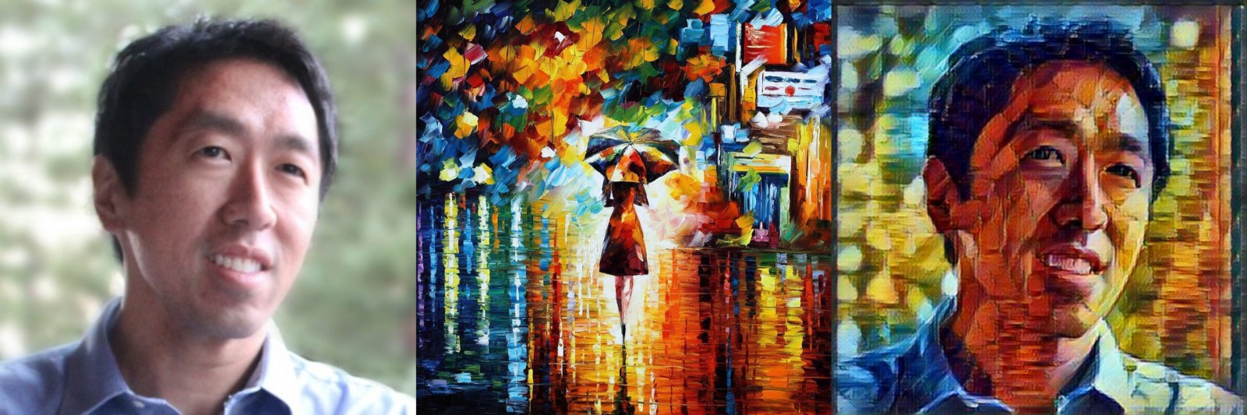
Neural Style Transfer

Slide 36
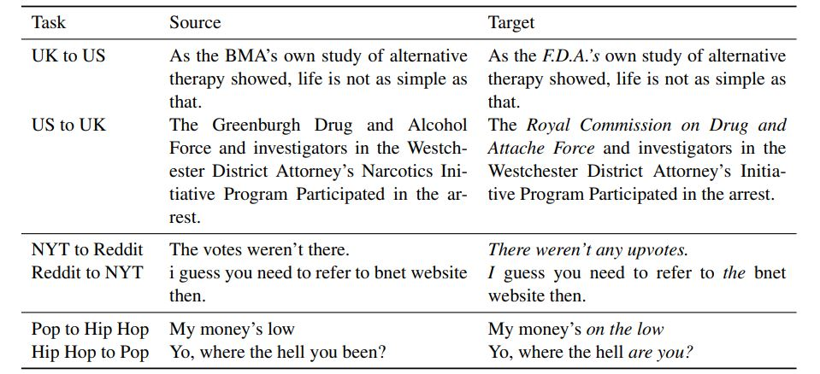
Text Style Transfer
(Lee et al, 2019)

Slide 37
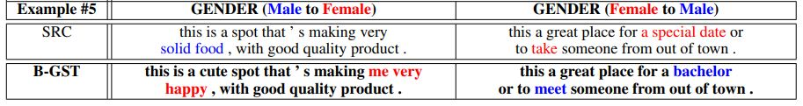
Gender Style Transfer
(Sudhakar et al, 2019)

Slide 38
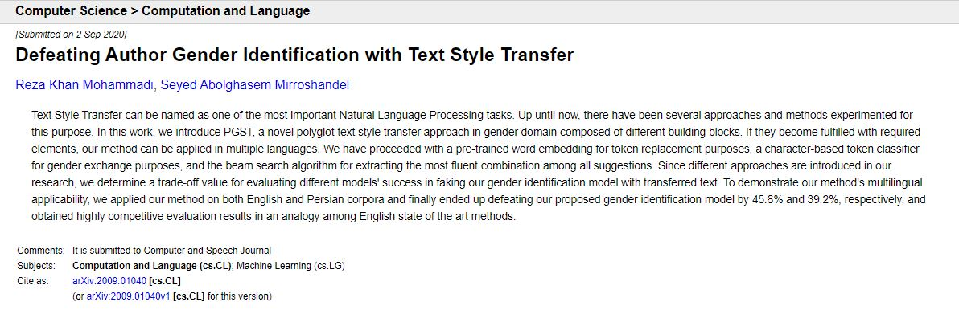
PGST: a Polyglot Gender Style Transfer method
https://arxiv.org/abs/2009.01040

Slide 39
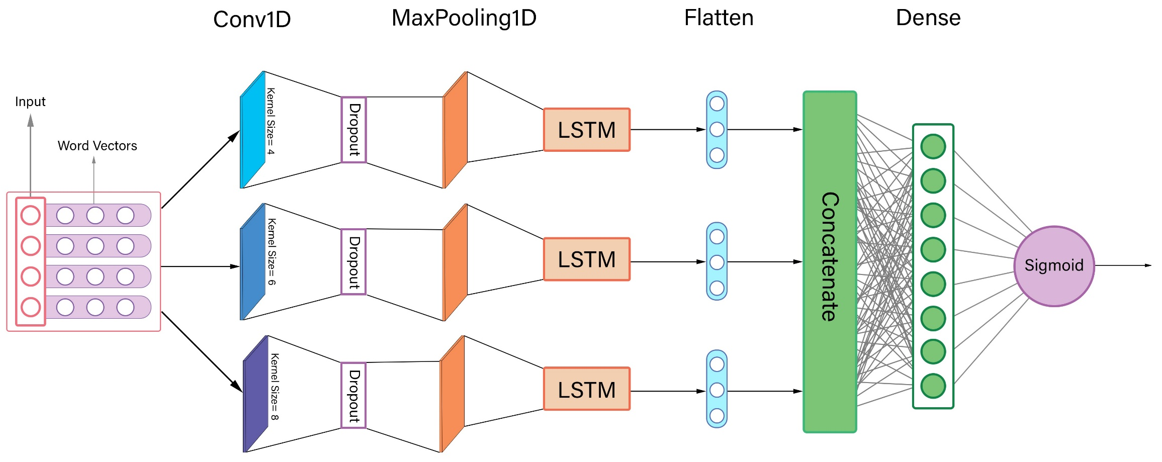
Gender Identification
(Khan Mohammadi and Mirroshandel, 2020)

Slide 40
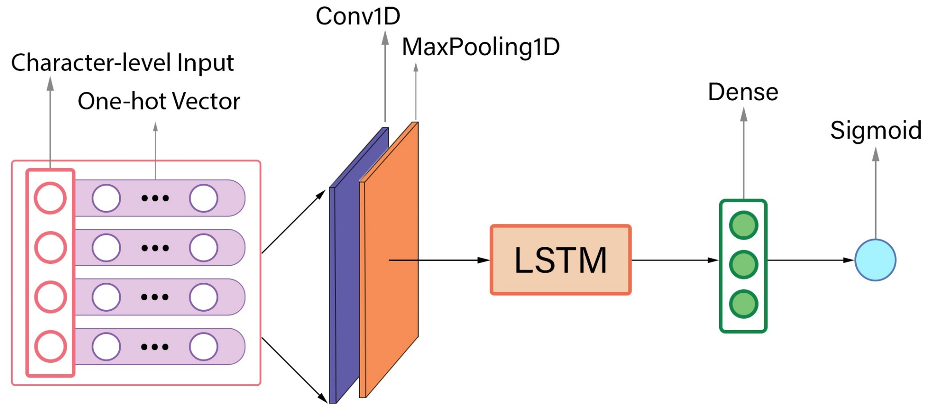
Character-based Token Classifier
(Khan Mohammadi and Mirroshandel, 2020)

Slide 41
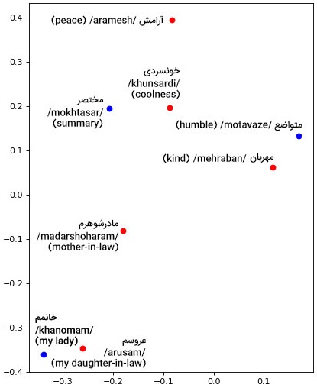
Character-based Token Classifier
(Khan Mohammadi and Mirroshandel, 2020)

Slide 42
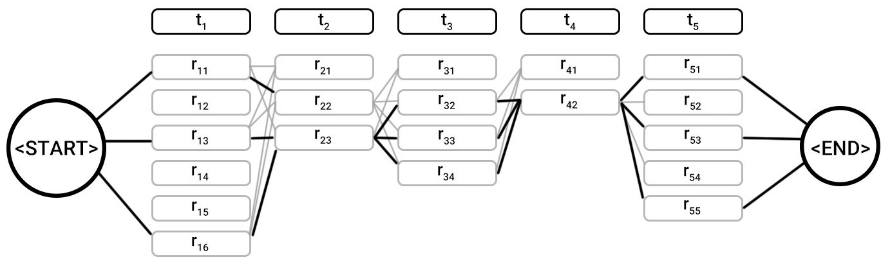
Approach
(Khan Mohammadi and Mirroshandel, 2020)

Slide 43
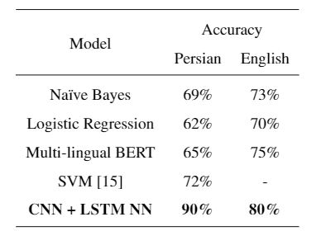
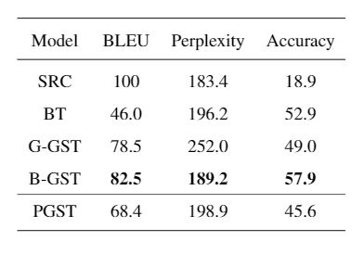
Results
(Khan Mohammadi and Mirroshandel, 2020)

Slide 44
Get in touch !

Slide 45
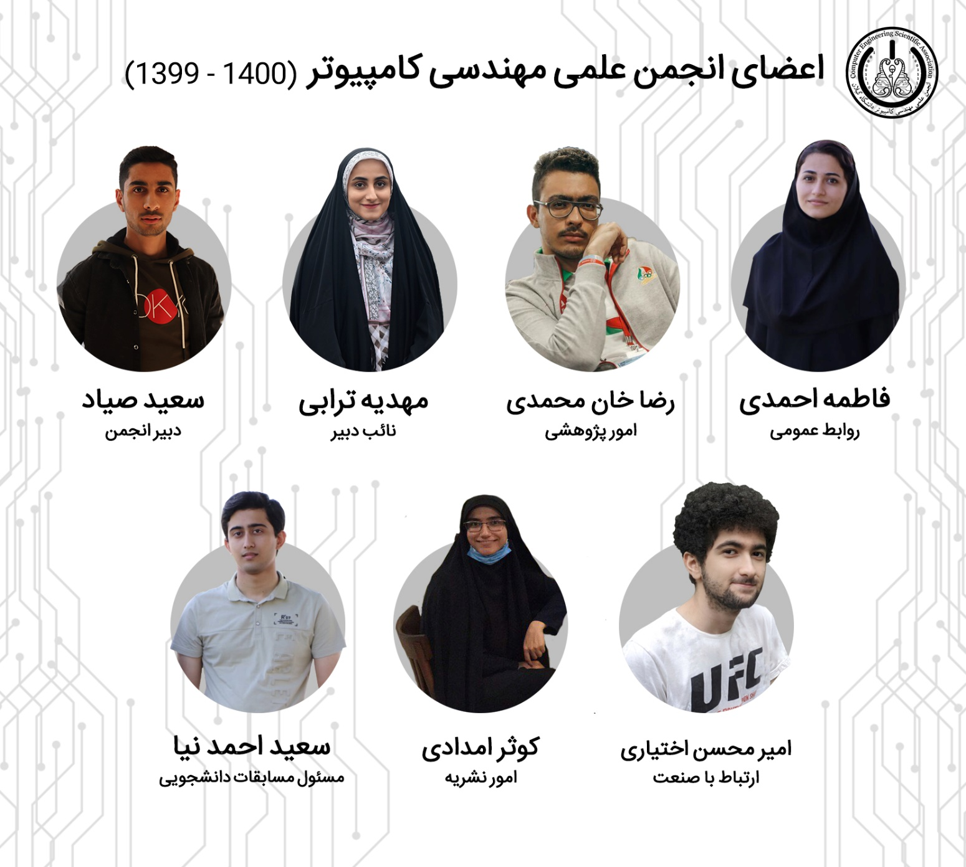
Scientific Association of the Computer Engineering Department

Slide 46
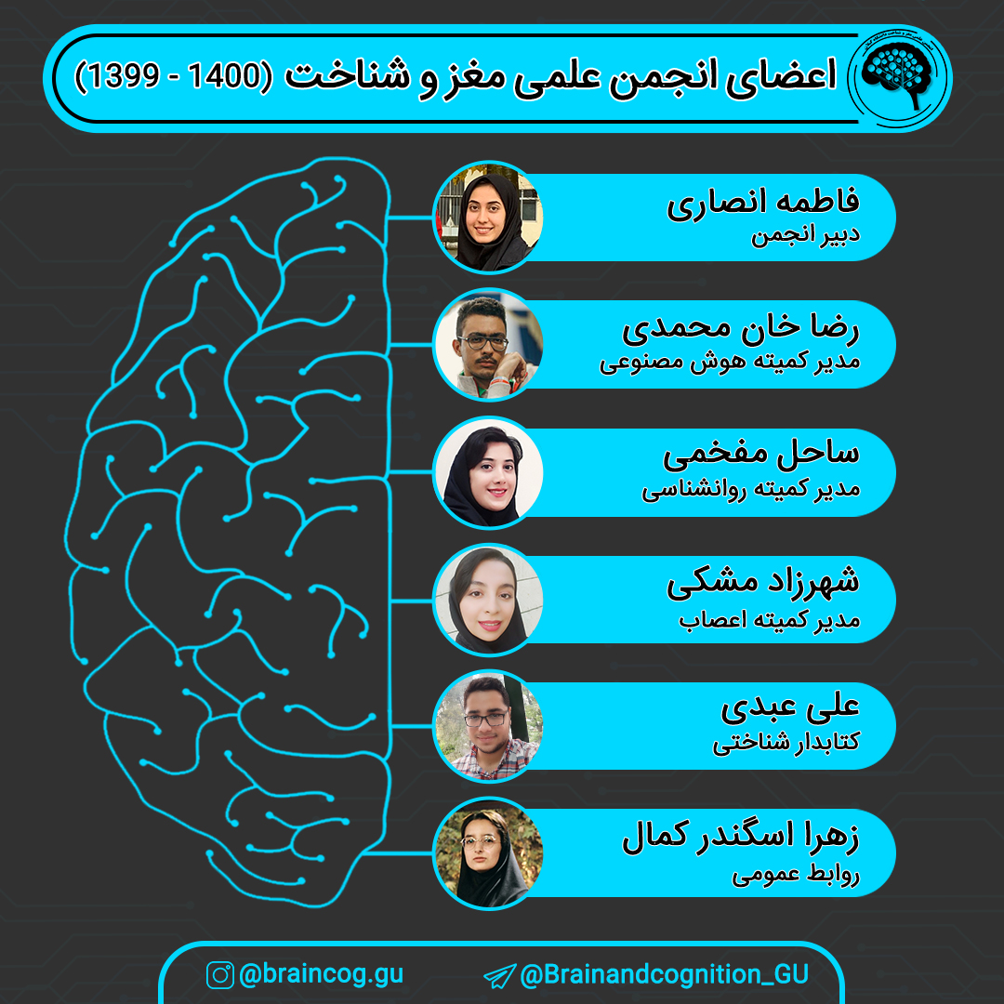
Brain and Cognition Scientific Association

Slide 47


Contact
@ledengary
ledengary.github.io

Slide 48

Thank
you
for
your
attention !

